Slide 1
Azure app service

Slide 2
Agenda
Azure app service building Blocks
Azure App Service Plan overview
Azure Mobile Apps
Introduction to Azure notification hub and Mobile engagement
Azure API apps & API Management
App Service Backup and Scaling
Azure App Service Security
App Service Monitoring
Azure Content Delivery Network
Azure Media Services and Search

Slide 3
Azure App Service building blocks
App Service Plan & Environment
Features like – Web Apps , API Apps , Mobile Back end Services, Web Jobs and functions
Other related services – Notification Hub, Mobile engagement, Azure search, Media services.
API Management
Virtual network and On-Premises communication
P2S VPN
ASE Only
Hybrid Connection manager
Automation – Scale up and Scale Down
Auto Scaling – Scale out and scale in
Performance – Content Delivery Network
High Availability-Load Balancing – Traffic Manager
App Service Backup
Monitoring
Security – SSL, Active Directory, Key Vault

Slide 4
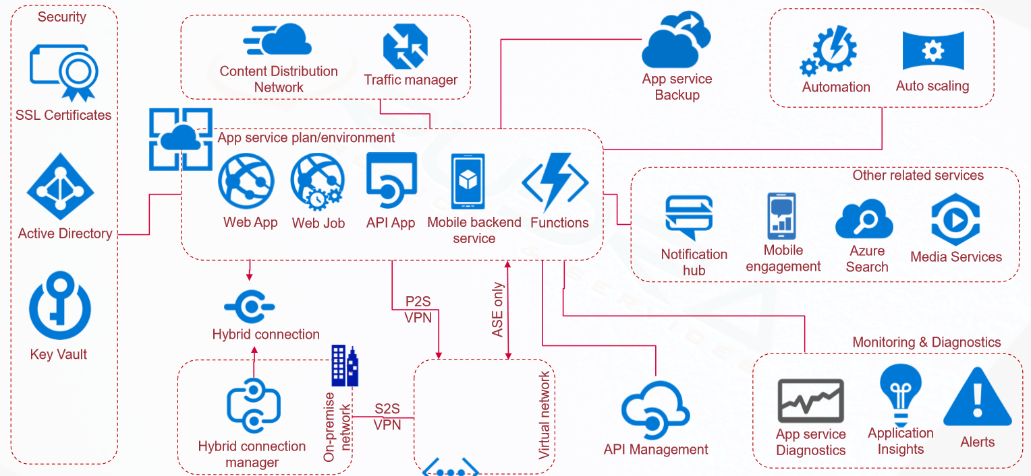
Azure App Service building blocks

Slide 5
App Service PLAN

Slide 6
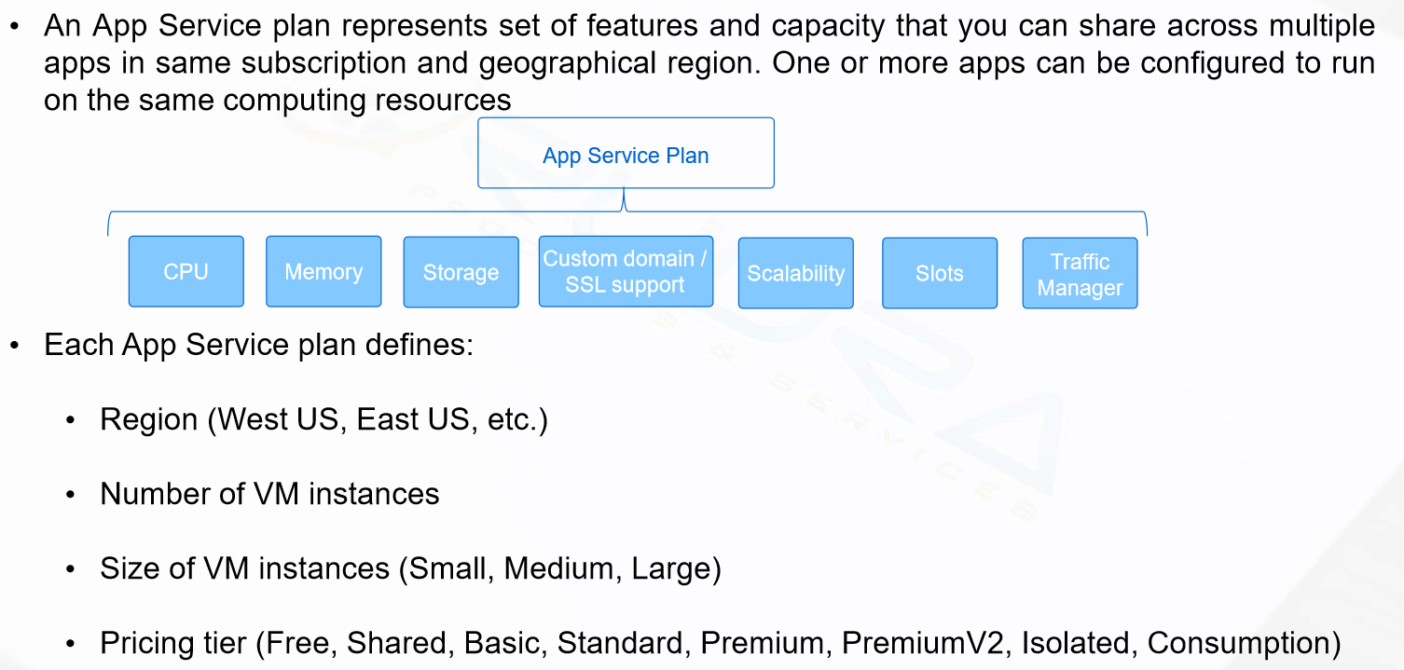
App Service PLAN Overview

Slide 7
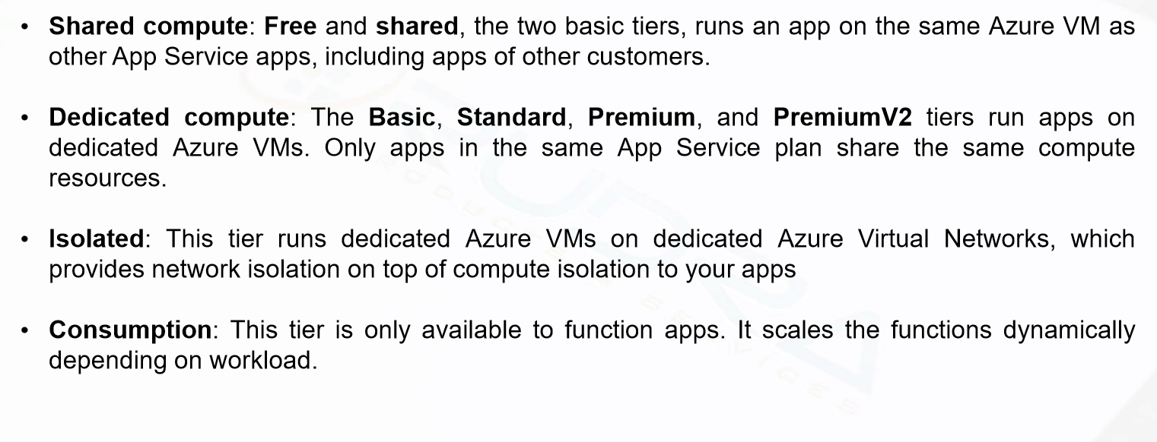
App Service PLAN – Pricing tiers

Slide 8
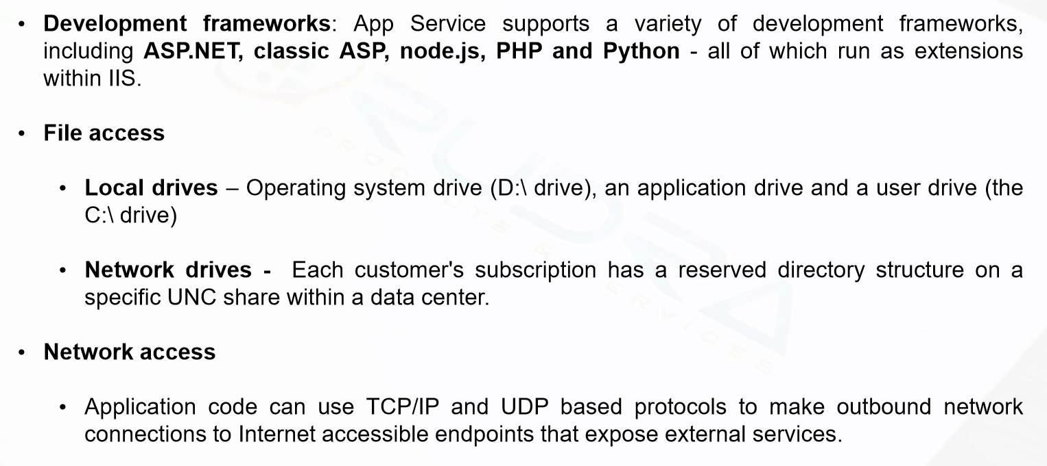
App service plan – Environment features

Slide 9
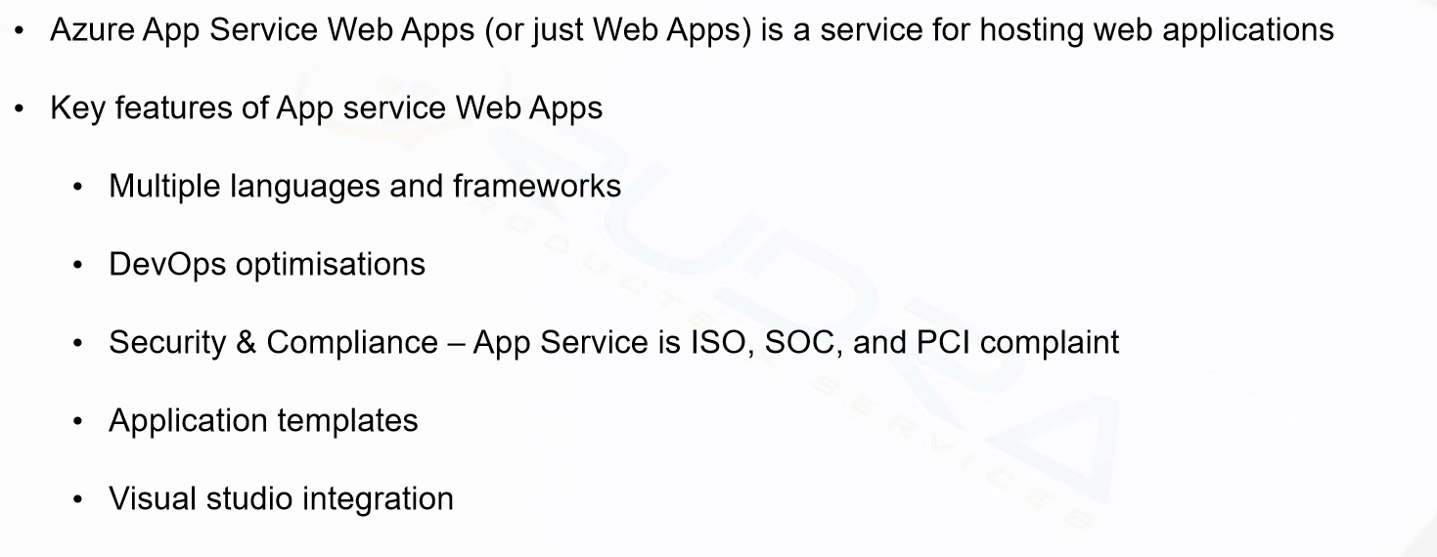
Web Apps overview

Slide 10
CREATE App Service and walk through key features-DEMO

Slide 11
Deploying an application into azure web app from visual studio

Slide 12
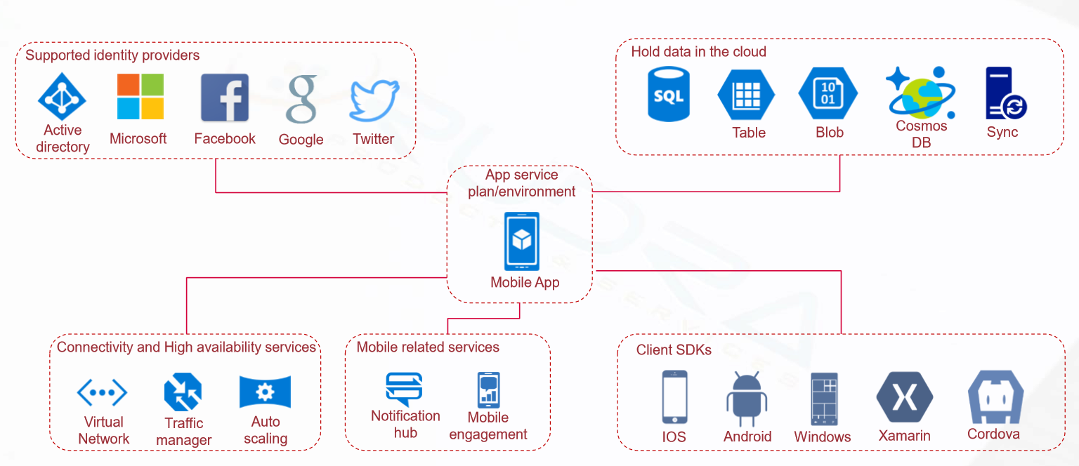
Azure mobile apps overview

Slide 13
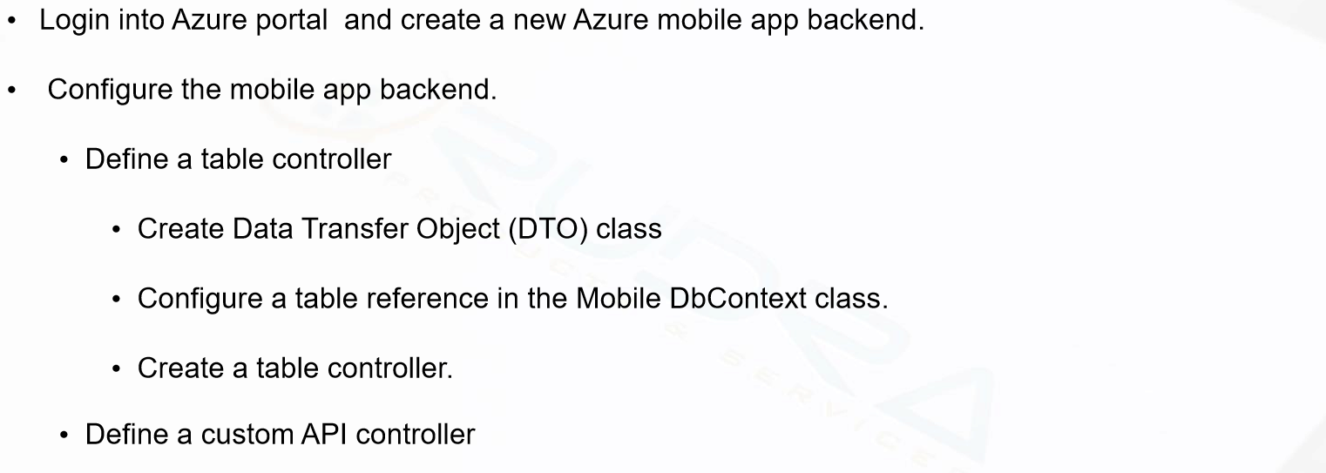
Mobile Apps Backend development

Slide 14

mobile client side development

Slide 15
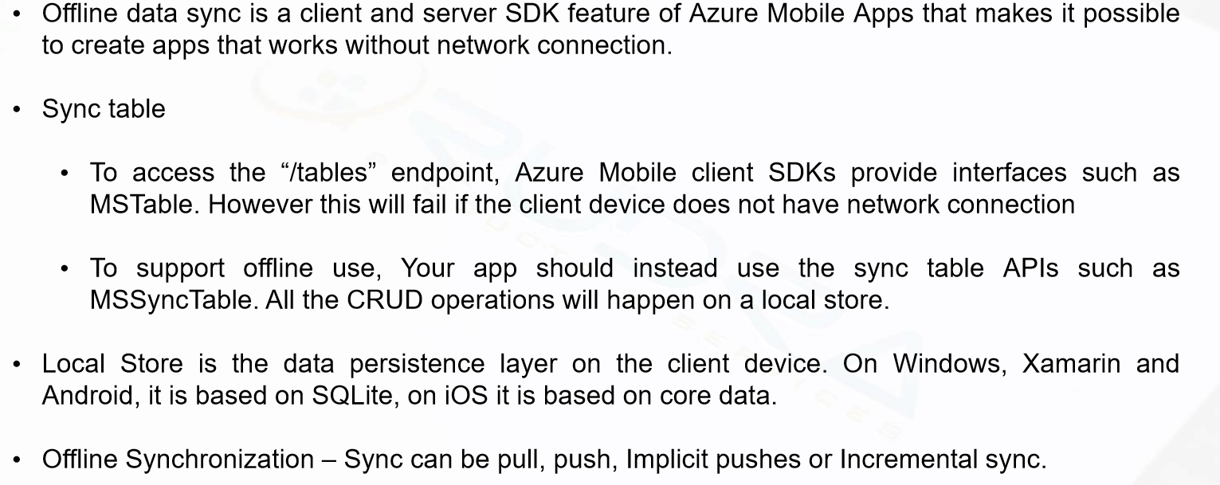
Mobile offline data sync

Slide 16
Azure notification hub and Mobile engagement

Slide 17
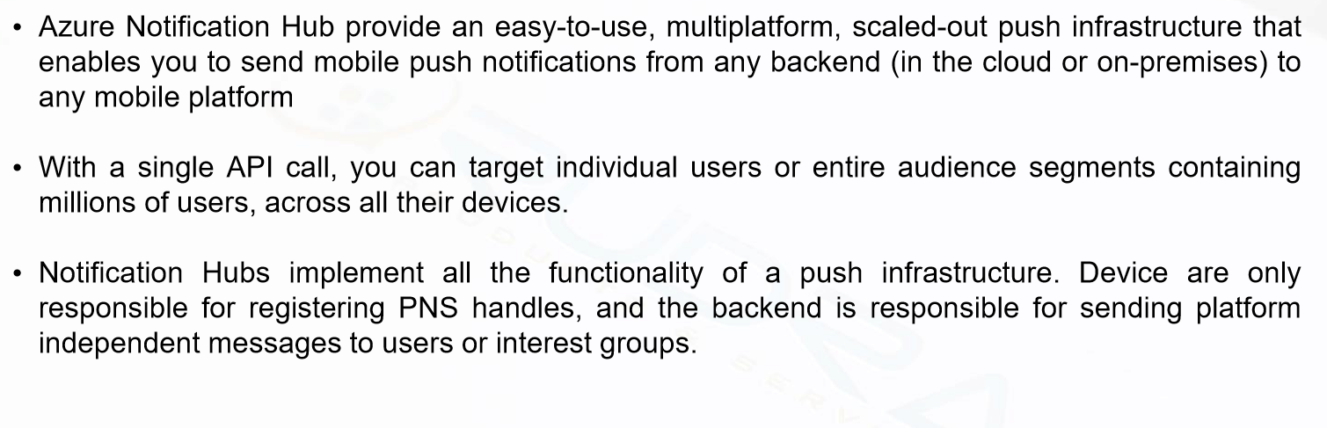
Azure Notification hub overview

Slide 18
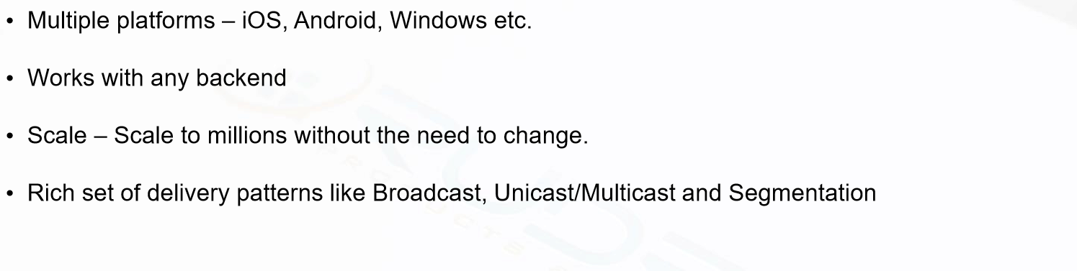
Azure Notification hub advantages

Slide 19
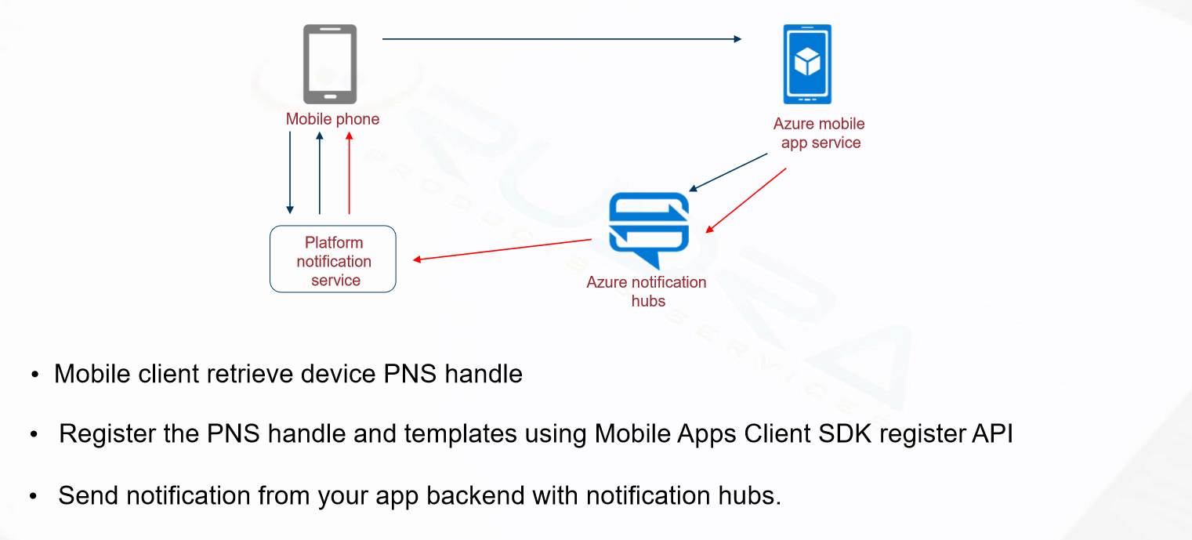
Azure Notification Hubs – How it works

Slide 20
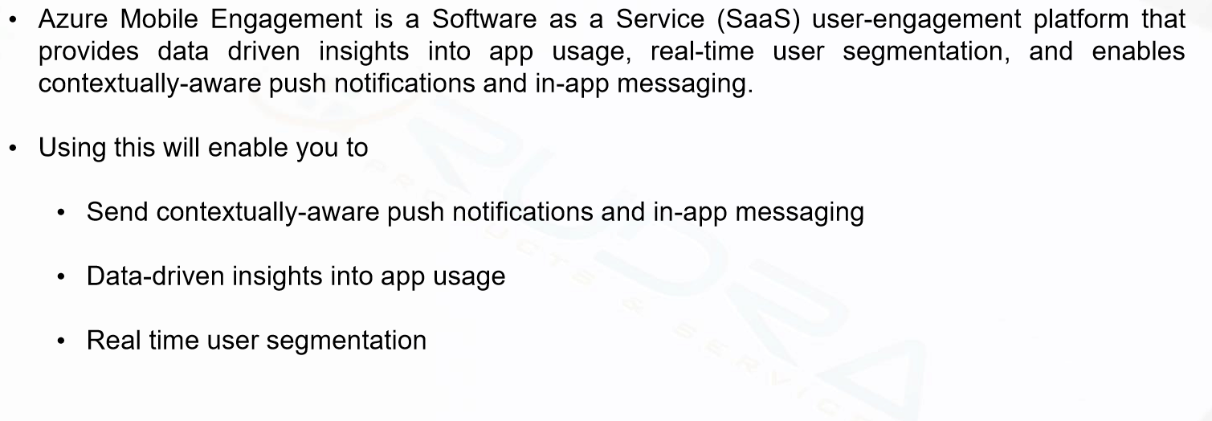
Azure mobile engagement

Slide 21
Azure API apps & api Management

Slide 22
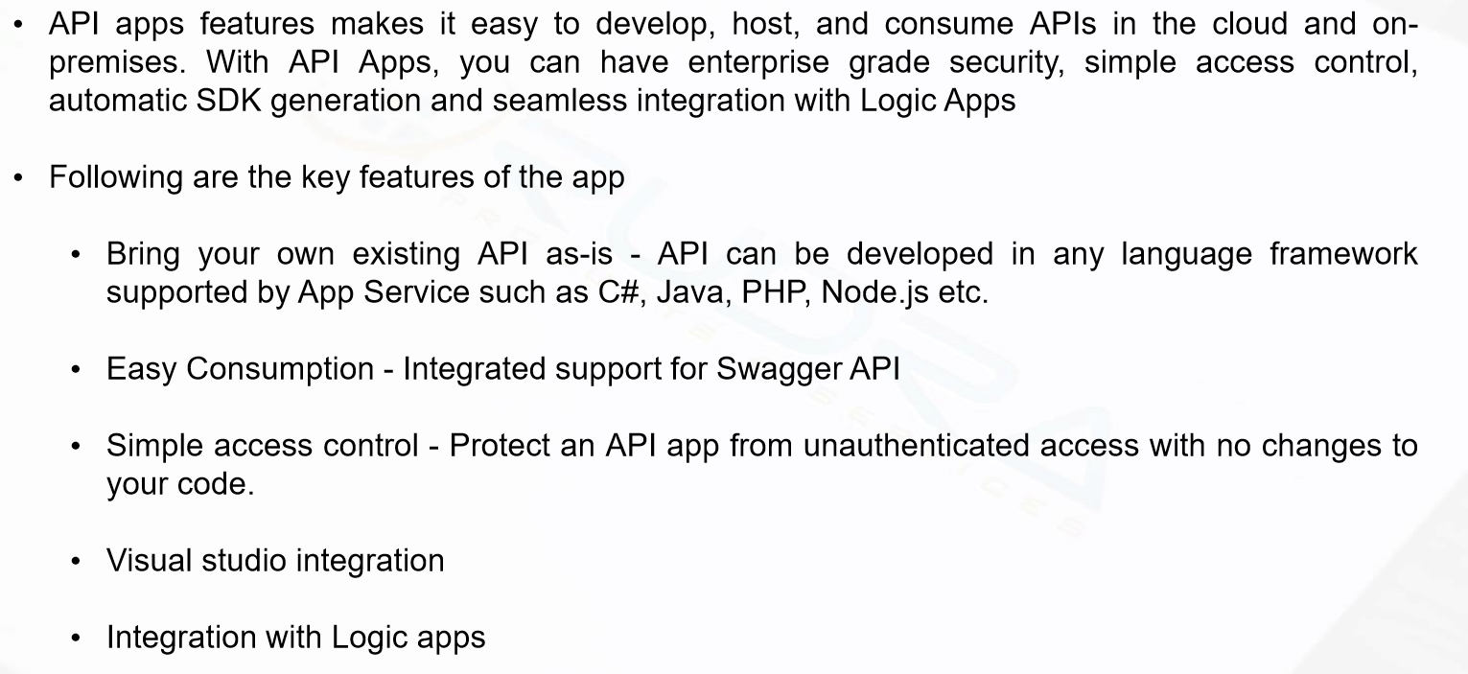
API apps overview

Slide 23
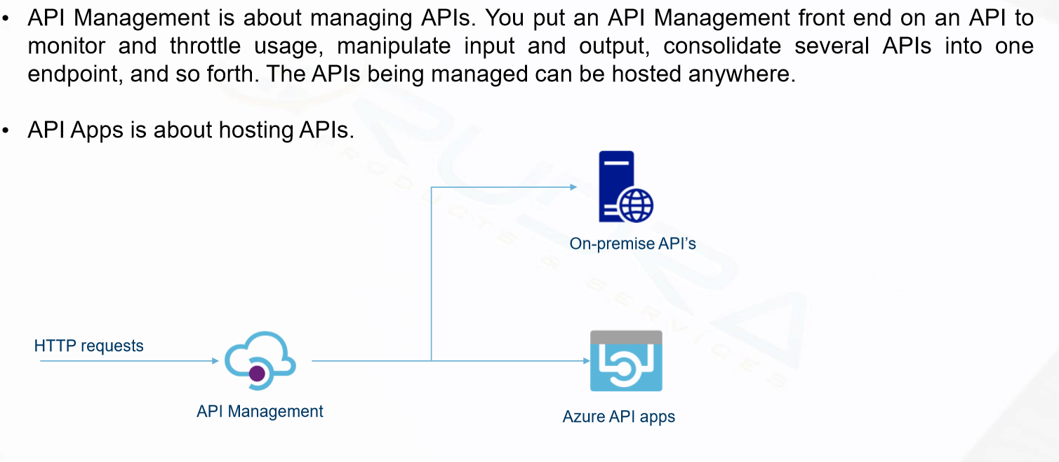
API management overview

Slide 24
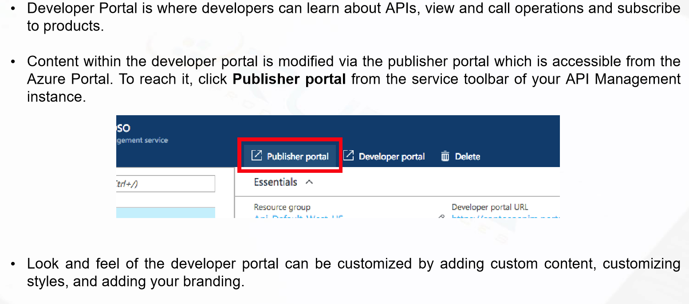
API management portals

Slide 25
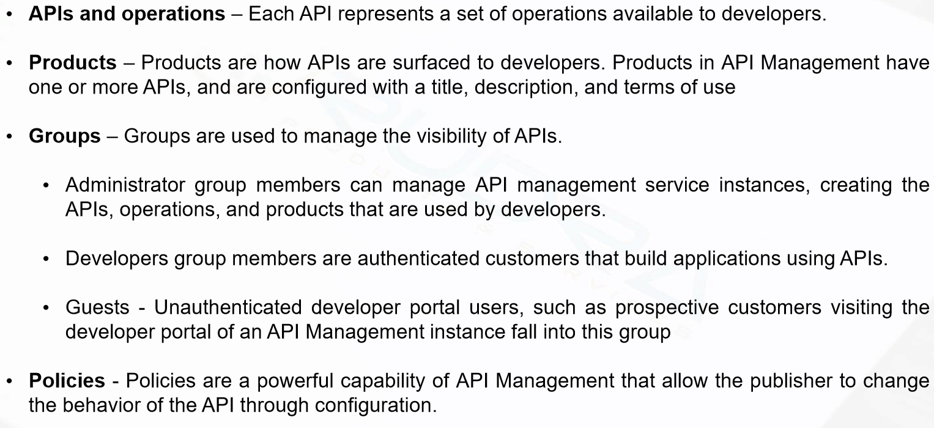
API management concept

Slide 26
Azure API service and API management demo

Slide 27
Azure App Service Backup & Scaling

Slide 28
App service Backup
The Backup and Restore feature in Azure App Service lets you easily create app backups
App service will backup following information
App configuration
File content
Database connected to your app

Slide 29
Backup restoration
Restore app with its linked database on-demand to its previous state (or)
Create a new app using app’s backups
Restoring from backups is available to apps running in Standard and Premium tier.

Slide 30
Ways to auto scale
Scaling manually
Scaling based on pre-set metric
Scaling based on other metrics
Scaling based on schedule

Slide 31
Azure App Service security

Slide 32
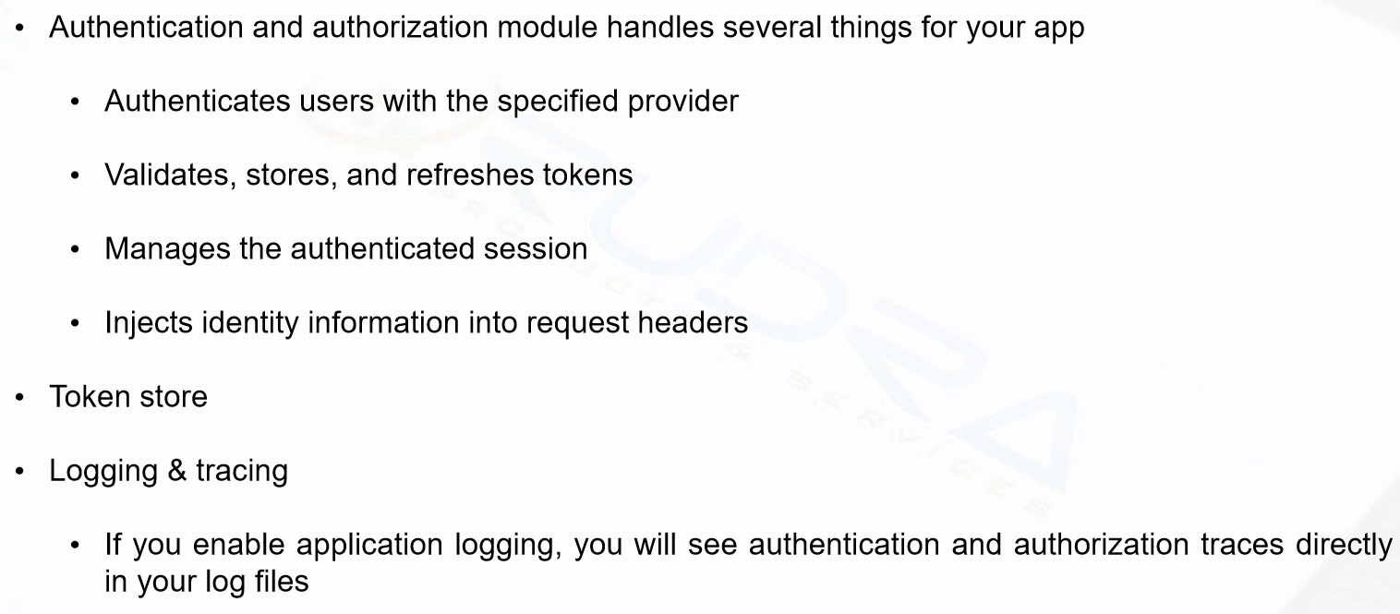
Authentication and authorization

Slide 33
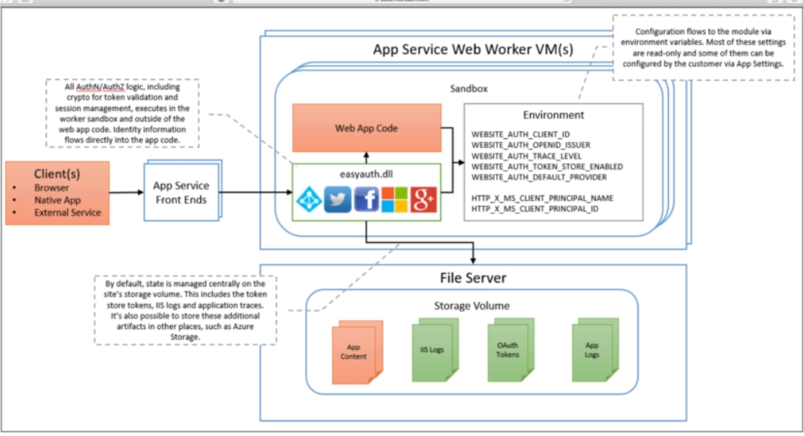

Slide 34

Other security areas

Slide 35
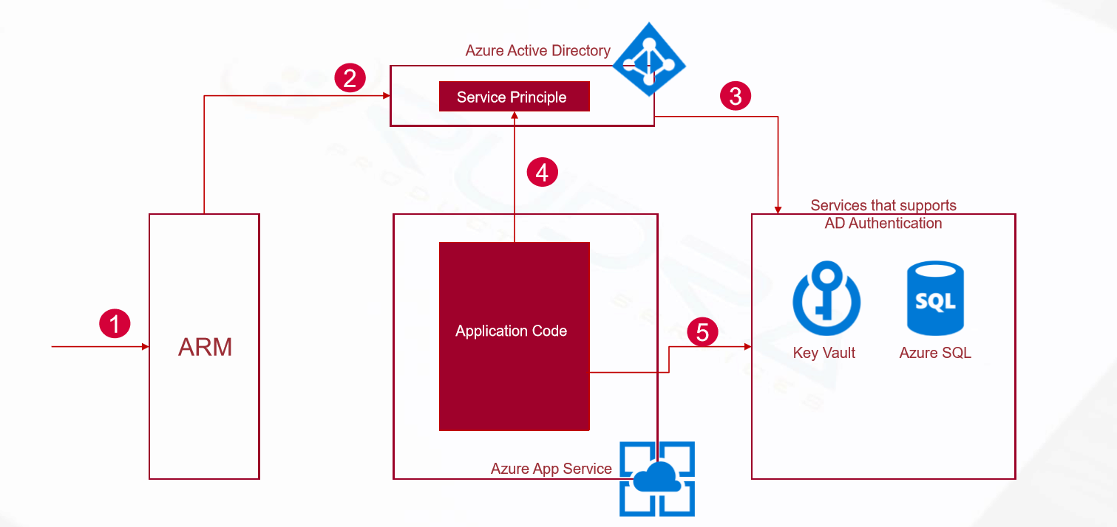
Managed service identity

Slide 36
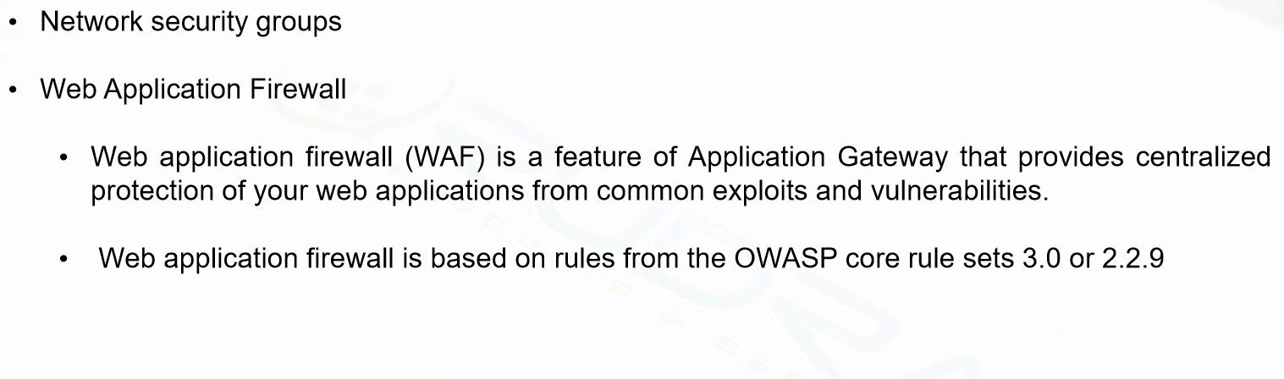
App Service Environments security

Slide 37
App Service Security Demo
Provide access to other users to administer App service
Access Control- contributor and owner
Managed service identity
SSL - encryption
Authentication/Authorization

Slide 38
App Service Monitoring

Slide 39
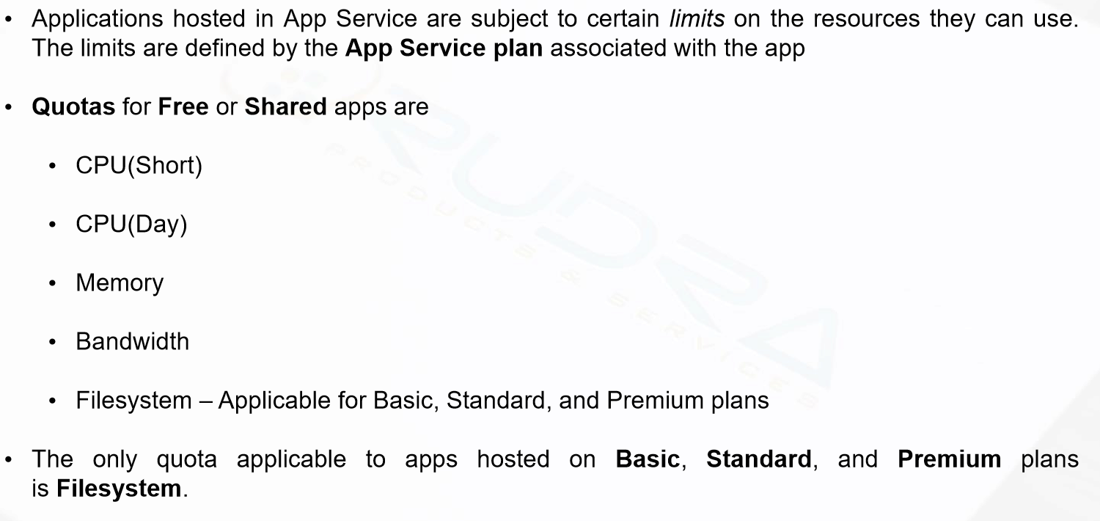
Quotas

Slide 40
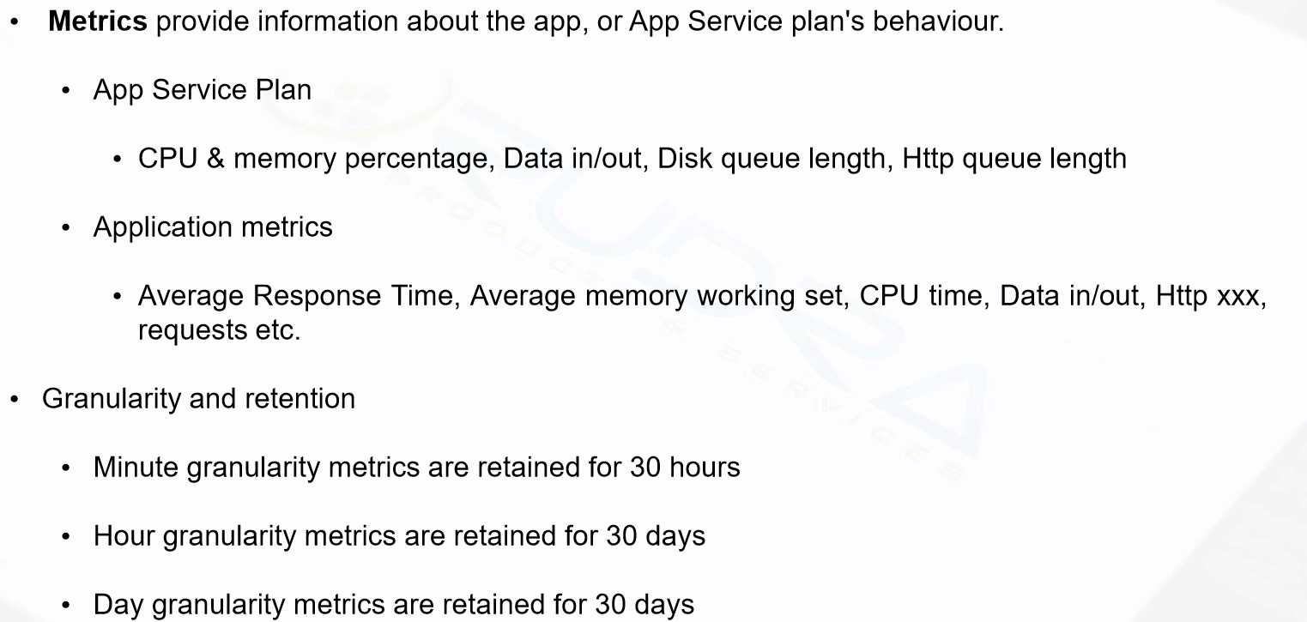
Metrics

Slide 41
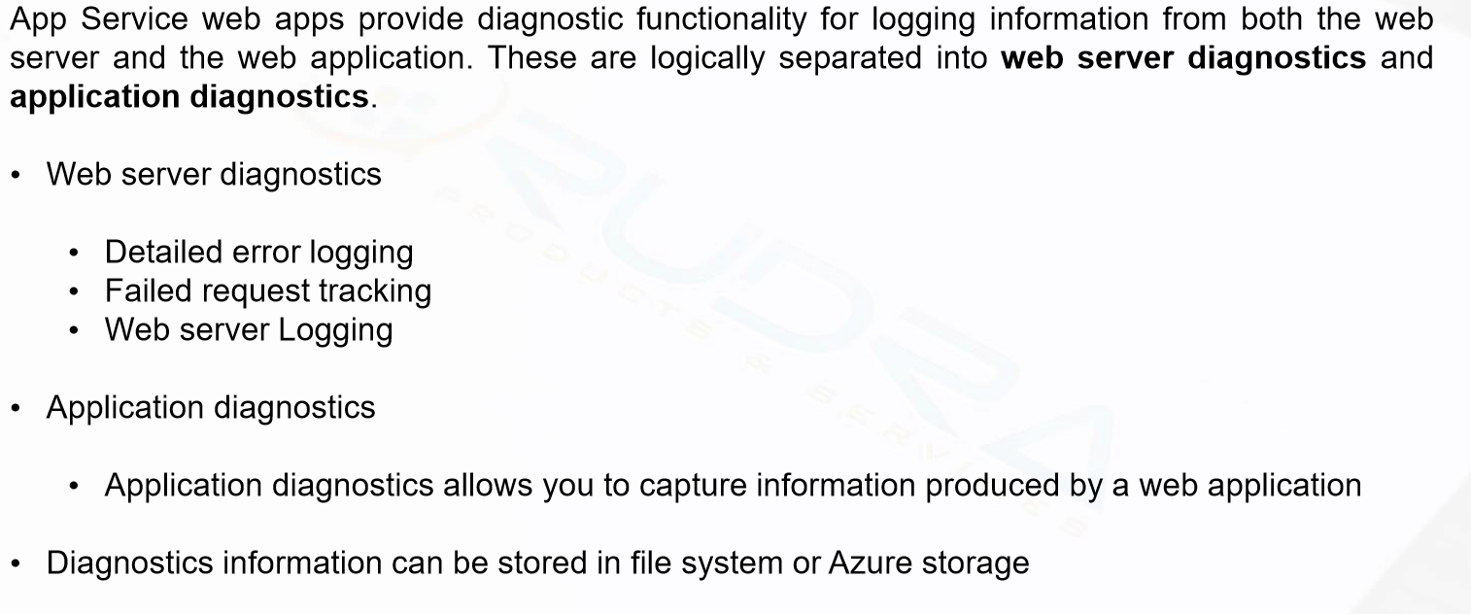
Diagnostics

Slide 42
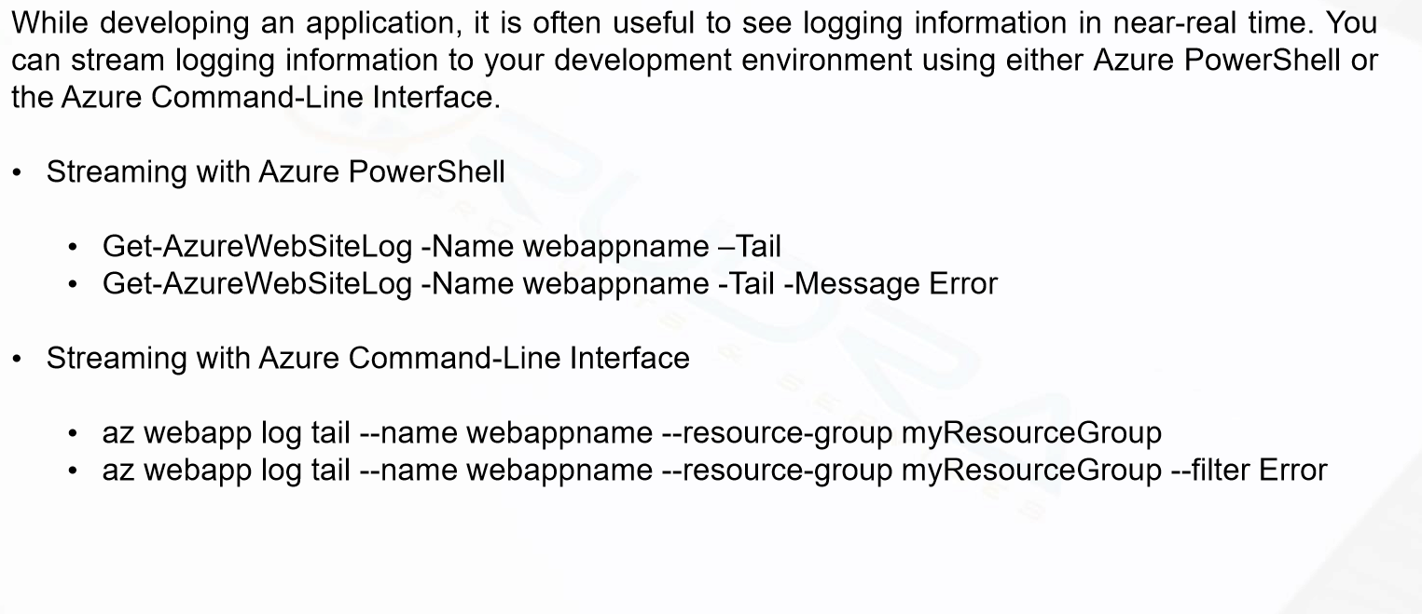
Stream logs

Slide 43
App service monitoring Demo
Activity Log
Metrics
Application level
App Service plan level
Application insights
Alerts
Diagnostic logs
Log Streaming

Slide 44
Azure content delivery network

Slide 45
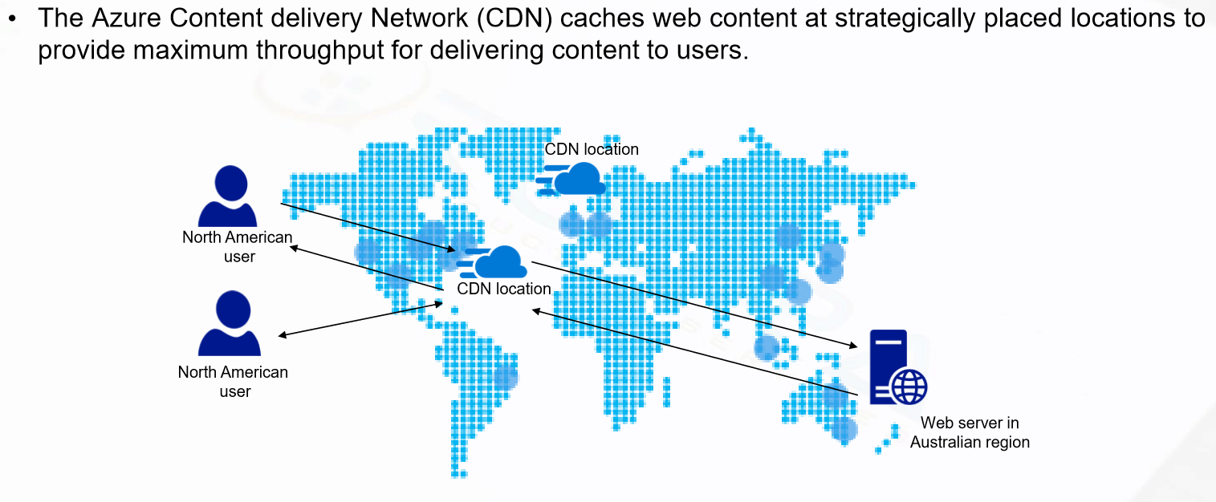
Overview

Slide 46

CDN Products

Slide 47

CDN features

Slide 48
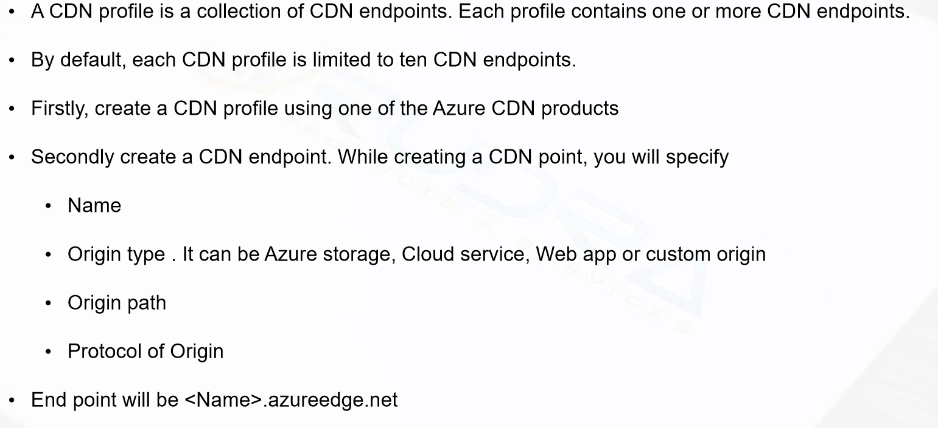
CDN Profile & CDN endpoints

Slide 49

Ways to control how files are cached

Slide 50
AZURE media services and search

Slide 51
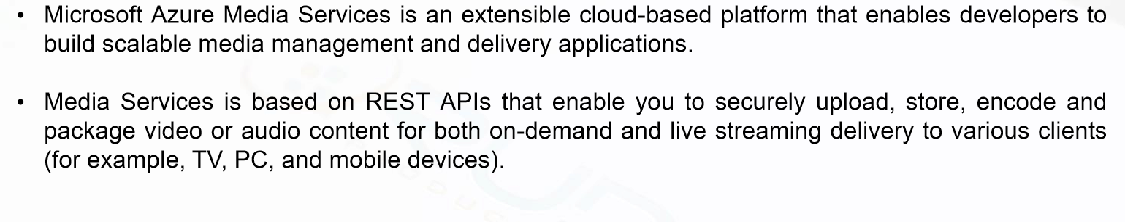
Media service overview

Slide 52
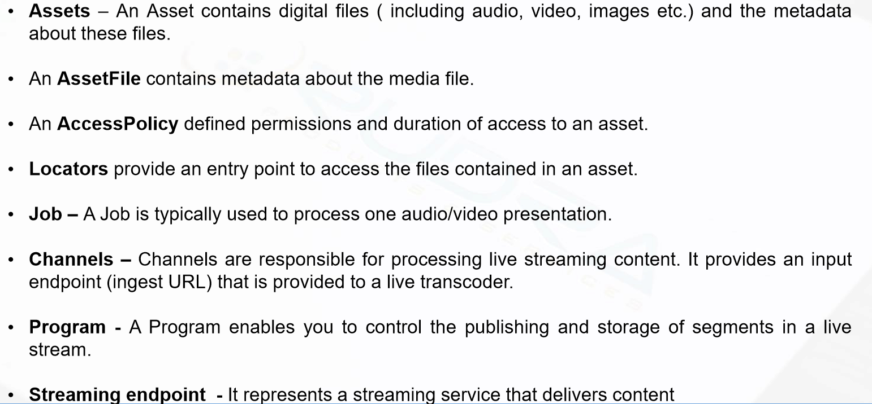
MEDIA Services concepts

Slide 53
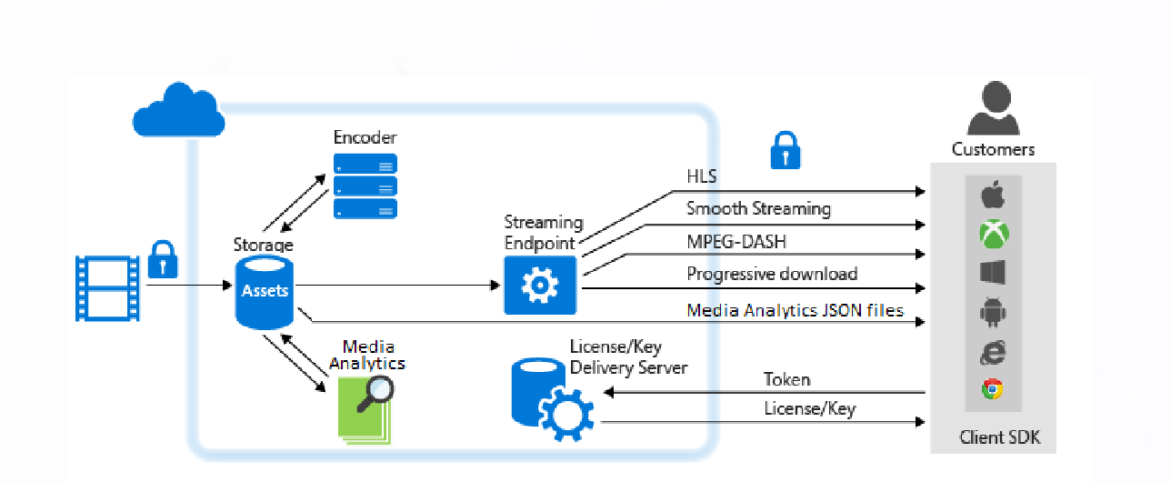
Media Services Scenarios – Delivering onDemand

Slide 54
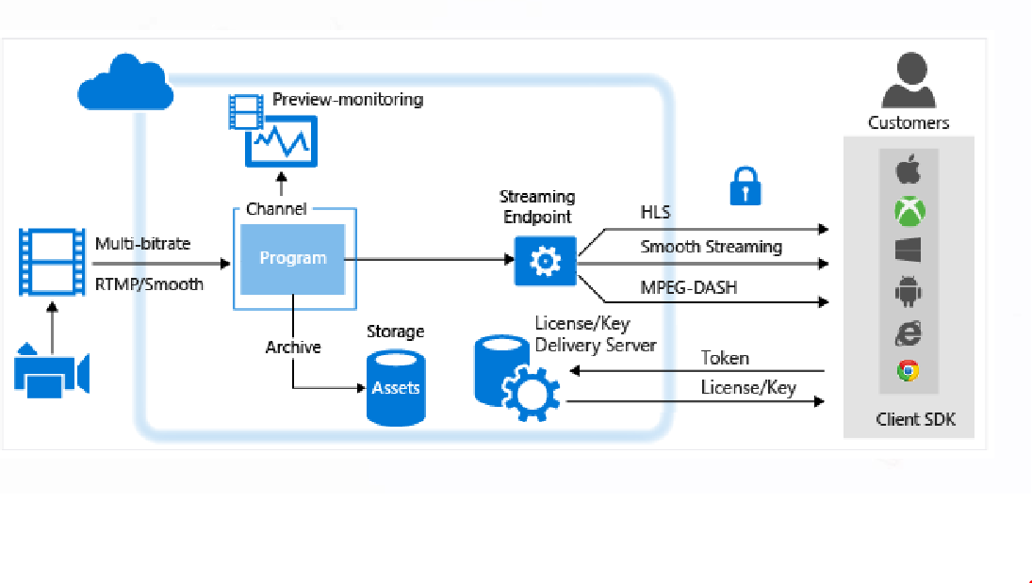
Media Services Scenarios – Delivering live stream events

Slide 55
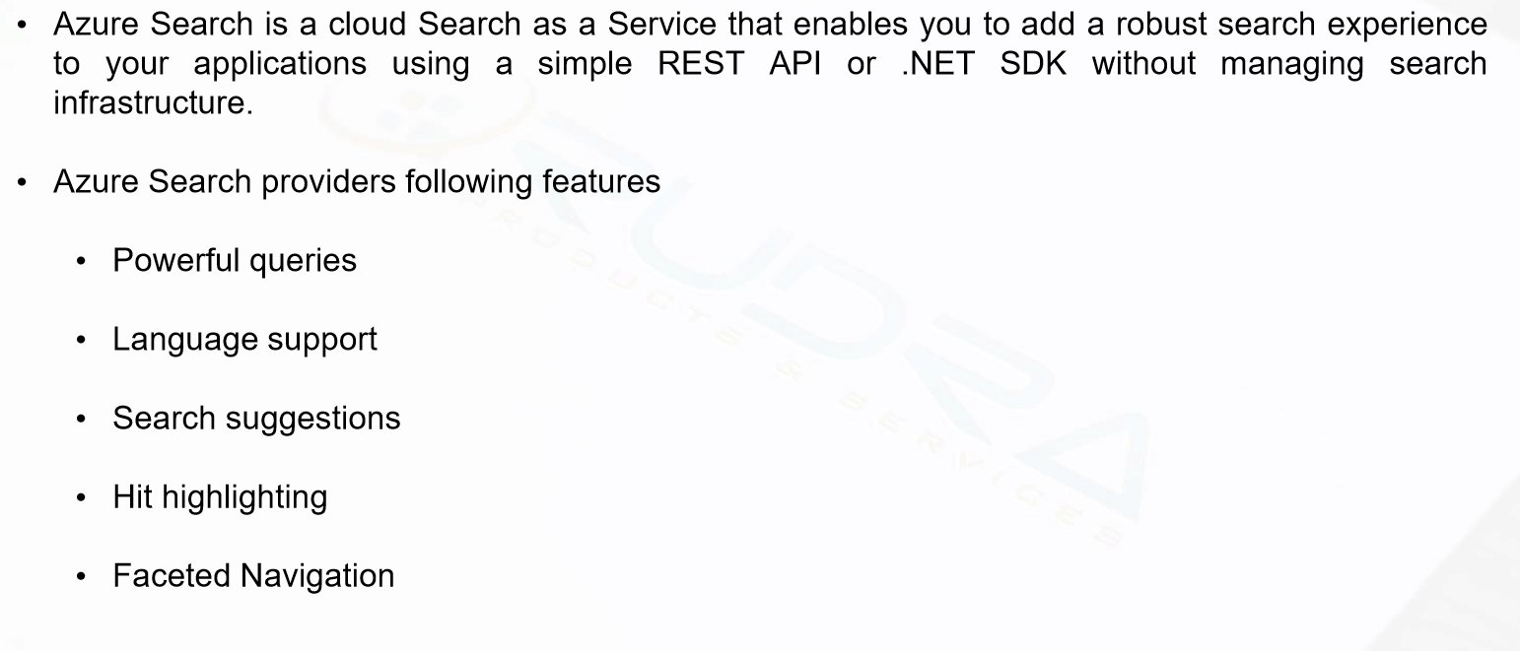
Azure Search

